Slide 1

INTRODUCTION TO BIG DATA ANALYTICS
Author : FU
Date : Mar-2022

Slide 2
Objectives
After studying this chapter, the student should be able to understand the key concepts:
Clarify what is meant by Big Data?
Why advanced analytics are needed?
How Data Science differs from Business Intelligence (BI)?
What new roles are needed for the new Big Data ecosystem?

Slide 3
Content
1. Big Data Overview
2. State of the Practice in Analytics
3. Key Roles for the New Big Data Ecosystem
4. Examples of Big Data Analytics

Slide 4
1. Big Data Overview – Where Big Data comes?
Data created constantly, and at an ever-increasing rate. Mobile phones, social media, Imaging technologies … create new data, stored some where for some purpose. Devices and sensors automatically generate diagnostic information that needs to be stored and processed in real time.
Merely keeping up with this huge influx of data is difficult, more challenging in analyzing vast amount of data, especially non-conform traditional data structure
Challenges of data deluge present the opportunity to transform business, government, science, and everyday life
Several industries led the way in the ability to gather and exploit data:
Credit card companies
Mobile phone companies
For companies such as LinkedIn and Facebook

Slide 5
1. Big Data Overview – What is Big data?
Three attributes stand out as defining Big Data characteristics:
Huge volume of data
Complexity of data types and structures (variety of new data sources, formats, and structures)
Speed of new data creation and growth
Big Data is sometimes described as having 3 Vs:
volume,
variety,
and velocity
Another definition of Big Data comes from the McKinsey Global report from 2011:
Big Data is data whose scale, distribution, diversity, and/or timeliness require the use of new technical architectures and analytics to enable insights that unlock new sources of business value.

Slide 6
1. Big Data Overview – What methods and tools used for Big data analysis?
Cannot be efficiently analyzed using only traditional databases or methods.
Require new tools and technologies to store, manage, and realize the benefits
New tools and technologies enable creation, manipulation, and management of large datasets and the storage environments
McKinsey’s definition of Big Data implies that organizations will need new data architectures and analytic sandboxes, new tools, new analytical methods, and an integration of multiple skills into the new role of the data scientist

Slide 7
1. Big Data Overview – What’s Driving Data Deluge?
Several sources of the Big Data deluge. The rate of data creation is accelerating, driven by many of the items in Figure 1-1.

Slide 8
1. Big Data Overview - Fastest-growing sources of Big Data?
Social media and genetic sequencing are among the fastest-growing sources of Big Data
Social media data
2012 Facebook users posted 700 status updates per second worldwide
Facebook construct social graphs to analyze users data
Genetic sequencing
Genetic sequencing and human genome mapping provide a detailed understanding of genetic makeup and lineage
Health care industry is looking toward these advances to help predict which illnesses a person is likely to get in his lifetime and take steps to avoid these maladies or reduce their impact through the use of personalized medicine and treatment
Notes:
As illustrated by the examples of social media and genetic sequencing, individuals and organizations both derive benefits from analysis of ever-larger and more complex datasets that require increasingly powerful analytical capabilities

Slide 9
1.1 Data Structures
Big data forms: structured and non-structured data (financial data, text files, multimedia files, and genetic mappings)
Most of the Big Data is unstructured or semi-structured, requires different techniques and tools to process and analyze

Slide 10
1.1 Data Structures – Data types
Structured data: Data containing a defined data type, format, and structure
Semi-structured data: Textual data files with a discernible pattern that enables parsing (such as Extensible Markup Language [XML] data files that are self-describing and defined by an XML schema)
Quasi-structured data: Textual data with erratic data formats that can be formatted with effort, tools, and time (for instance, web clickstream data that may contain inconsistencies in data values and formats)
Unstructured data: Data that has no inherent structure, which may include text documents, PDFs, images, and video

Slide 11
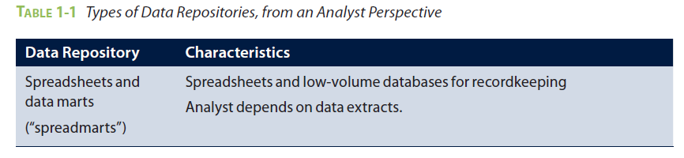
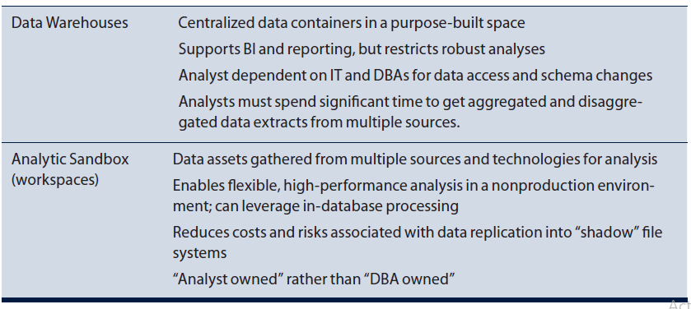
1.2 Analyst Perspective on Data Repositories

Slide 12
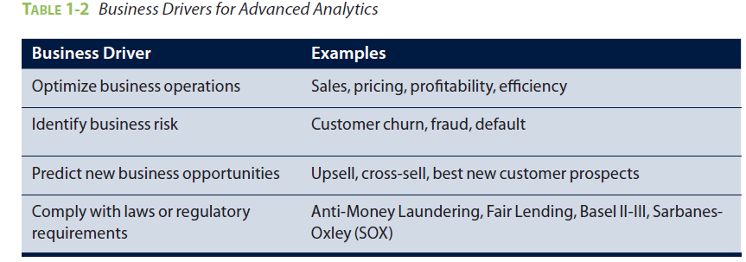
2. State of the Practice in Analytics
Business problems provide many opportunities for organizations to become more analytical and data driven, as shown in Table 1-2

Slide 13
2.1 BI versus Data Science - What is BI?
Several ways to compare these groups of analytical techniques
BI tends to provide reports, dashboards, and queries on business questions (closed-ended and explain current or past behavioral) for the current period or in the past
BI systems used to answer questions related to quarter-to-date revenue, progress toward quarterly targets, and understand how much of a given product was sold in a prior quarter or year
BI provides hindsight and some insight and generally answers questions related to “when” and “where” events occurred
BI problems tend to require highly structured data organized in rows and columns for accurate reporting

Slide 14
2.1 BI versus Data Science - What is Data Science?
Use disaggregated data in a more forward-looking, exploratory way, focusing on analyzing the present and enabling informed decisions about the future.
Be more exploratory in nature and may use scenario optimization to deal with more open-ended questions, focusing on questions related to “how” and “why” events occur.
Data Science projects tend to use many types of data sources, including large or unconventional datasets

Slide 15
2.1 BI versus Data Science - Summary
Notes:
1) BI tends to provide reports, dashboards, and queries on business questions for the current period or in the past. BI systems make it easy to answer questions related to
quarter-to-date revenue, progress toward quarterly targets, and understand how much of a given product was sold in a prior quarter or year. These questions tend to be closed-ended and explain current or past behavior, typically by aggregating historical data and grouping it in some way. BI provides hindsight and some insight and generally answers questions related to “when” and “where” events occurred.
2) Data Science tends to use disaggregated data in a more forward-looking, exploratory way, focusing on analyzing the present and enabling informed decisions about the future. Rather than aggregating historical data to look at how many of a given product sold in the previous quarter, a team may employ Data Science techniques such as time series analysis, further discussed in Chapter 8, “Advanced Analytical Theory and Methods: Time Series Analysis,” to forecast future product sales and revenue more
accurately than extending a simple trend line

Slide 16
2.2 Analytical Architecture
FIGURE 1-9 Typical analytic architecture
Notes:
1) For data sources to be loaded into the data warehouse, data needs to be well understood, structured, and normalized with the appropriate data type definitions. Although this kind of centralization enables security, backup, and failover of highly critical data, it also means that data typically must go through significant preprocessing and checkpoints before it can enter this sort of controlled environment, which does not lend itself to data exploration and iterative analytics.
2) As a result of this level of control on the EDW, additional local systems may emerge in the form of departmental warehouses and local data marts that business users create to accommodate their need for flexible analysis. These local data marts may not have the same constraints for security and structure as the main EDW and allow users to do some level of more in-depth analysis. However, these one-off systems reside in isolation, often are not synchronized or integrated with other data stores, and may not be backed up.
3) Once in the data warehouse, data is read by additional applications across the enterprise for BI and reporting purposes. These are high-priority operational processes getting critical data feeds from the data warehouses and repositories.
4) At the end of this workflow, analysts get data provisioned for their downstream analytics. Because users generally are not allowed to run custom or intensive analytics on production databases, analysts create data extracts from the EDW to analyze data offline in R or other local analytical tools. Many times these tools are limited to in-memory analytics on desktops analyzing samples of data, rather than the entire population of a dataset. Because these analyses are based on data extracts, they reside in a separate location, and the results of the analysis—and any insights on the quality of the data or anomalies—rarely are fed back into the main data repository.

Slide 17
2.3 Drivers of Big Data
Data now comes from multiple sources:
Medical information
Photos and video
Video surveillance
Mobile devices
Smart devices
Nontraditional IT devices
FIGURE 1-10 Data evolution and the rise of Big Data sources

Slide 18
2.4 Emerging Big Data Ecosystem and a New Approach to Analytics
New ecosystem takes shape, there are four main groups of players within this interconnected web
Data devices
Data collectors
Data aggregators
Data users and buyers
FIGURE 1-11 Emerging Big Data ecosystem
Notes:
1) Data devices [shown in the (1) section of Figure 1-11] and the “Sensornet” gather data from multiple locations and continuously generate new data about this data. For each gigabyte of new data created, an additional petabyte of data is created about that data
2) Data aggregators (the dark gray ovals in Figure 1-11, marked as (3)) make sense of the data collected from the various entities from the “SensorNet” or the “Internet of Things.” These organizations compile data from the devices and usage patterns collected by government agencies, retail stores, and websites
3) Data users and buyers are denoted by (4) in Figure 1-11. These groups directly benefit from the data collected and aggregated by others within the data value chain.

Slide 19
3. Key Roles for the New Big Data Ecosystem (1)
FIGURE 1-12 Key roles of the new Big Data ecosystem
Notes:
1) Deep Analytical Talent— is technically savvy, with strong analytical skills. Members possess a combination of skills to handle raw, unstructured data and to apply complex analytical techniques at massive scales. This group has advanced training in quantitative disciplines, such as mathematics, statistics, and machine learning
2) Data savvy professionals :include financial analysts, market research analysts, life scientists, operations managers, and business and functional managers.
3) Technology and Data Enablers. This group represents people providing technical expertise to support analytical projects, such as provisioning and administrating analytical sandboxes, and managing large-scale data architectures that enable widespread analytics within companies and other organizations.

Slide 20
3. Key Roles for the New Big Data Ecosystem (2)
Three recurring sets of activities for data scientists
Reframe business challenges as analytics challenges
Design, implement, and deploy statistical models and data mining techniques on Big Data
Develop insights that lead to actionable recommendations
Required main skills for data scientists
Quantitative skill
Technical aptitude
Skeptical mind-set and critical thinking
Curious and creative
Communicative and collaborative:
FIGURE 1-13 Profile of a Data Scientist

Slide 21
4. Examples of Big Data Analytics
An example of this is the U.S. retailer Target. Charles Duhigg’s book The Power of Habit discusses how Target used Big Data and advanced analytical methods to drive new revenue. After analyzing consumer purchasing behavior, Target’s statisticians determined that the retailer made a great deal of money from three main life-event situations.
Marriage, when people tend to buy many new products
Divorce, when people buy new products and change their spending habits
Pregnancy, when people have many new things to buy and have an urgency to buy them
Hadoop represents another example of Big Data innovation on the IT infrastructure. Apache Hadoop is an open source framework that allows companies to process vast amounts of information in a highly parallelized way
Social media e.g. LinkedIn (250 million user accounts) represents a tremendous opportunity to leverage social and professional interactions to derive new insights

Slide 22
Summary
Big Data comes from myriad sources, including social media, sensors, the Internet of Things, video surveillance, and many sources of data
Organizations evolve their processes and see the opportunities from Big Data. Move beyond traditional BI activities, such as using data to populate reports and dashboards, and move toward Data Science- driven projects that attempt to answer more open-ended and complex questions.
Big Data presents requires new data architectures, including analytic sandboxes, new ways of working, and people with new skill sets
Need to build Data Science team. Growing talent gap that makes finding and hiring data scientists in a timely manner difficult

